Slide 1
Space Packet Structural Components
SPACE PACKET
PACKET DATA FIELD
PACKET PRIMARY HEADER
PACKET SECONDARY HEADER
USER DATA FIELD
Variable
Variable
6 octets
1 to 65536 octets

Slide 2
Packet Primary Header – Bit-fields
PACKET PRIMARY HEADER
3
PACKET IDENTIFICATION
PACKET SEQUENCE CONTROL
PACKET VERSION NUMBER
PACKET DATA LENGTH
SEC. HDR. FLAG
APPLICATION PROCESS IDENTIFIER
PACKET SEQUENCE COUNT OR PACKET NAME
SEQUENCE FLAGS
PACKET TYPE
3 bits
1 bit
1 bit
11 bits
2 bits
14 bits
16 bits
2 octets
2 octets
2 octets

Slide 3
Packet Primary Header – Byte-fields
PACKET PRIMARY HEADER
3
PACKET IDENTIFICATION
PACKET SEQUENCE CONTROL
PACKET VERSION NUMBER
PACKET DATA LENGTH
SEC. HDR. FLAG
APPLICATION PROCESS IDENTIFIER
PACKET SEQUENCE COUNT OR PACKET NAME
SEQUENCE FLAGS
PACKET TYPE
1 byte:
0x00 – 0x01
1 byte: 0x00 – 0x01
2 bytes:
0x0000 – 0xFFFF
1 byte: 0x00 – 0x03
2 bytes: 0x0000 – 0xFFFF
2 bytes: 0x0000 – 0xFFFF
1 byte:
0x00
5 bytes
3 bytes
2 bytes

Slide 4
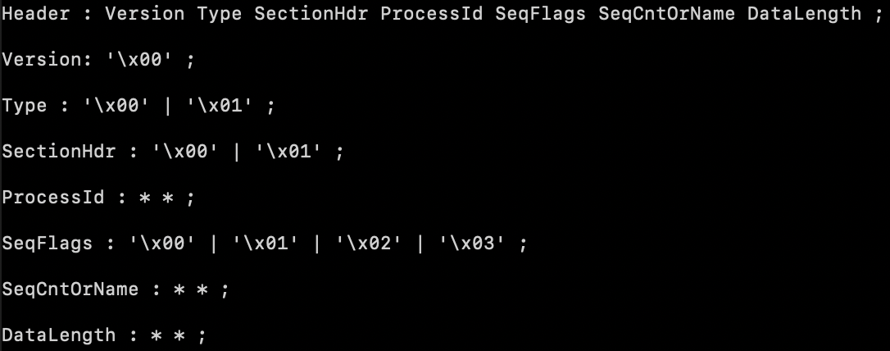
XBNF Grammar

Slide 5
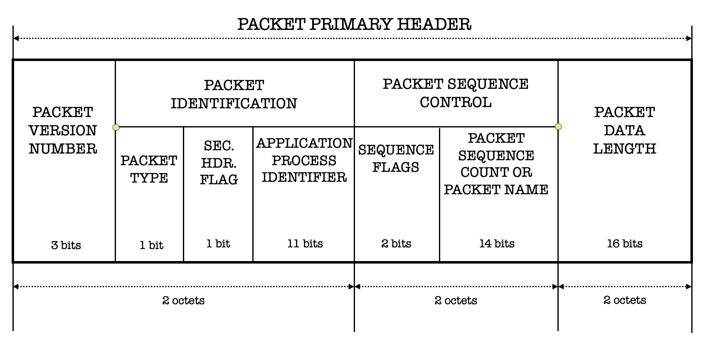
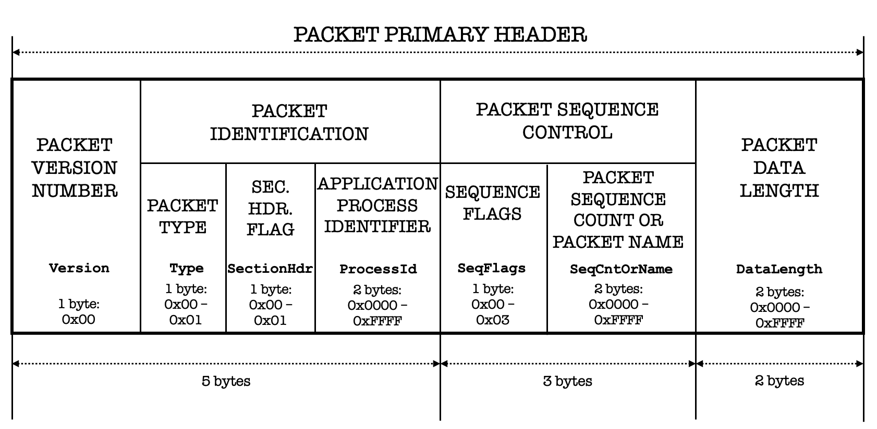
Bit-field SPP header:
Byte-field SPP header:
XBNF Grammar:

Slide 6
Screenshot for previous slide
PACKET PRIMARY HEADER
3
PACKET IDENTIFICATION
PACKET SEQUENCE CONTROL
PACKET VERSION NUMBER
PACKET DATA LENGTH
SEC. HDR. FLAG
APPLICATION PROCESS IDENTIFIER
PACKET SEQUENCE COUNT OR PACKET NAME
SEQUENCE FLAGS
PACKET TYPE
Version
Type
SectionHdr
ProcessId
SeqFlags
SeqCntOrName
DataLength
1 byte:
0x00 – 0x01
1 byte: 0x00 – 0x01
2 bytes:
0x0000 – 0xFFFF
1 byte: 0x00 – 0x03
2 bytes: 0x0000 – 0xFFFF
2 bytes: 0x0000 – 0xFFFF
1 byte:
0x00
5 bytes
3 bytes
2 bytes

